Slide 1

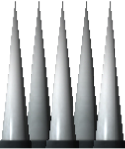
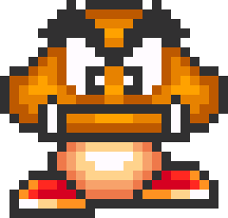
Super Gravity Goomba Stomp Spike Avoid Challenge
X-treme edition!!!
Controls:
A – left movement
D – right movement
Spacebar – invert player gravity
Avoid spikes:
Stomp Goombas:

